Slide 1
"Cholesterol Concentration Effects on Plasma Membrane Properties in Simulated Human Erythrocytes"
Hila Flumin Guidance: Prof. Tony Futerman & Dr. Tamir Dingjan Supervision: Dr. Einat Hazkani-Covo

Slide 2
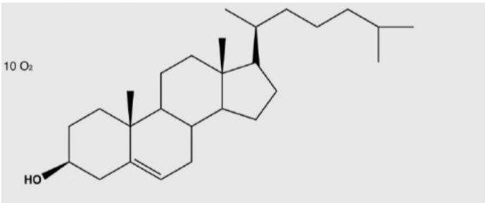
Introduction - Cholesterol
Cholesterol is the most abundant lipid in the mammalian cellular plasma membrane
A unique biochemical structure makes cholesterol a semi-planar, rigid and amphiphilic molecule
Cholesterol plays a significant role in the human body; both as a precursor of vitamins and hormones, and as a major building block of the plasma membrane with effect on behavior and structure
Cholesterol molecule

Slide 3
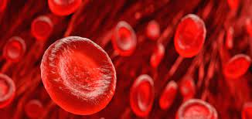
Introduction – RBCs Plasma Membranes
Their two-dimensional structure and rich body of literature make red blood cell’s membranes the default choice for lipidomics molecular dynamics studies
As cholesterol is the most common lipid in the RBCs membranes, it has a significant effect on it both biochemically and clinically, as connection between cardiovascular diseases and membranal cholesterol concentrations had been linked (Namazi et al., 2014)

Slide 4
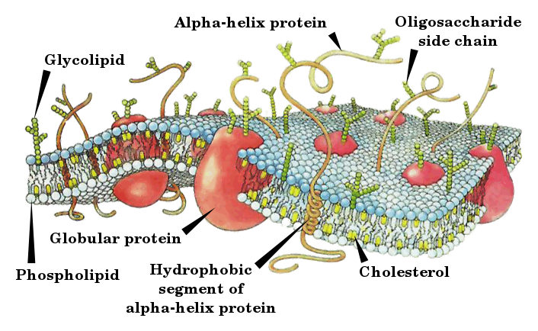
Introduction – The Membrane and Its Properties
The plasma membrane of the cell is composed of lipids and proteins bound together, giving it a semi-liquid state and the signature bilayer structure, as it is composed of two leaflets
The bilayer is made of a wide variety of lipids spread asymmetrically across it. Movement between leaflets is called “flip-flop” and rarely occurs in most lipids in the absence of flip-flop inducing enzymes such as Flippase, Floppase and Scramblase
Some of the most common lipids are: Cholesterol, Sphingolipids & sphingomyelins, and phospholipids such as the phosphoglycerolipids: phosphatidylserine (PS), phosphatidylcholine (PC), phosphatidylethanolamine (PE), phosphatidylinositol (PI) and others

Slide 5
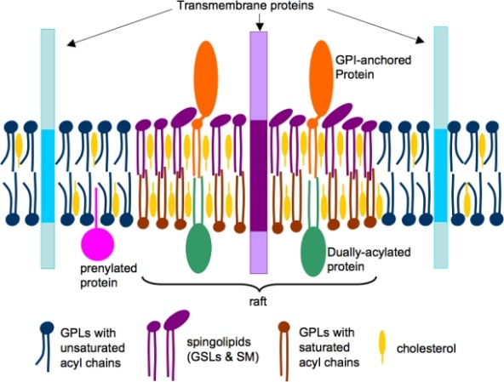
Introduction – Cholesterol and the membrane
Thanks to it chemical structure, cholesterol interactions with lipids and proteins are accountable for several phenomena in the bilayer, such as an effect on membrane rigidness and permeability
Another well known hypothesized phenomena is lipid rafts: domains of cholesterol, sphingolipids and proteins creating more solid and stable areas within the membrane
Despite its importance and the effect of cholesterol concentration on the cellular and RBC’s plasma membrane, the concentration is yet to be known, with a wide range of estimations across literature. It might be that it’s not constant and dependent on diet and other parameters, thus increasing the importance of understanding the effect of cholesterol concentration on the membrane

Slide 6
Methods
Step 1
Initial data Preparation and setup
Step 2
Membrane preparation
Step 3
Molecular dynamics simulation
Step 4
Data analysis
(composition grid tool)
(GROMACS)
(GROMACS + AWS)
(GROMACS, memly, lipy)
*Github links to composition grid and memly attached
Notes:
List all of the steps used in completing your experiment.
Remember to number your steps.

Slide 7
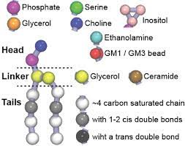
Initial Data & Membrane Preperation
Original lipidomics data from (Lorent at al., 2020) was rescaled in order to generate updated membranes with the fitting cholesterol concentrations, using a computational tool we developed called “composition grid”
The compositional data of every experiment was then uploaded to a dedicated molecular dynamics program called GROMACS v2020.6
Topologies of the membrane components were generated using GROMACS and python based on Martini Coarse-Grain force-field (figure A), then minimized and equilibrated.
A

Slide 8
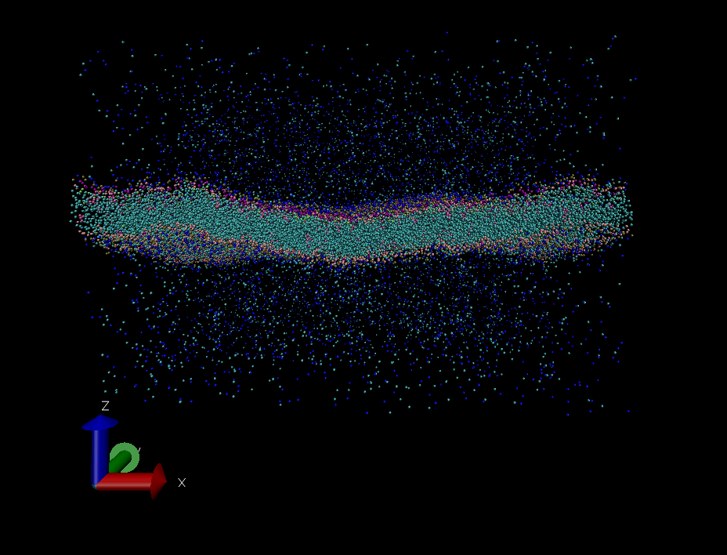
Molecular Dynamics (MD) Simulations
Molecular dynamics is a computational tool allowing for atomic and molecular scaled examination of biochemical dynamics, based on Newtonian physical equations
Experimental boxes containing a bilayer of ~5,000 lipids, water and ions were set using GROMACS
Experimental files were uploaded to Amazon Web Services (AWS) and were set to run for 20 μs

Slide 9
Analysis Methods
The analysis was mostly done in a program we developed called “memly”. The lipid order parameter analysis was based upon Lipyphilic (Smith & Lorenz., 2021)
Main principles of the analysis:
Mean sqaure displacement - $〈{\left(x\left(t\right)−x_{0}\right)}^{2}〉$
Bilayer thickness – Average of vectors between lipid’s head groups from both leaflets
Surface area – area of the lipid’s projection’s voronoi polygons
Order parameter – $S_{cc}=\frac{〈3∗{cosθ}^{2}−1〉}{2}$ , θ = The angle between the normal of the bilayer and the vector connecting two tail chain carbon atoms
Flop-flop rate – $r_{flip−flop}=\frac{n_{flip−flop}}{t_{simulation}}$

Slide 10
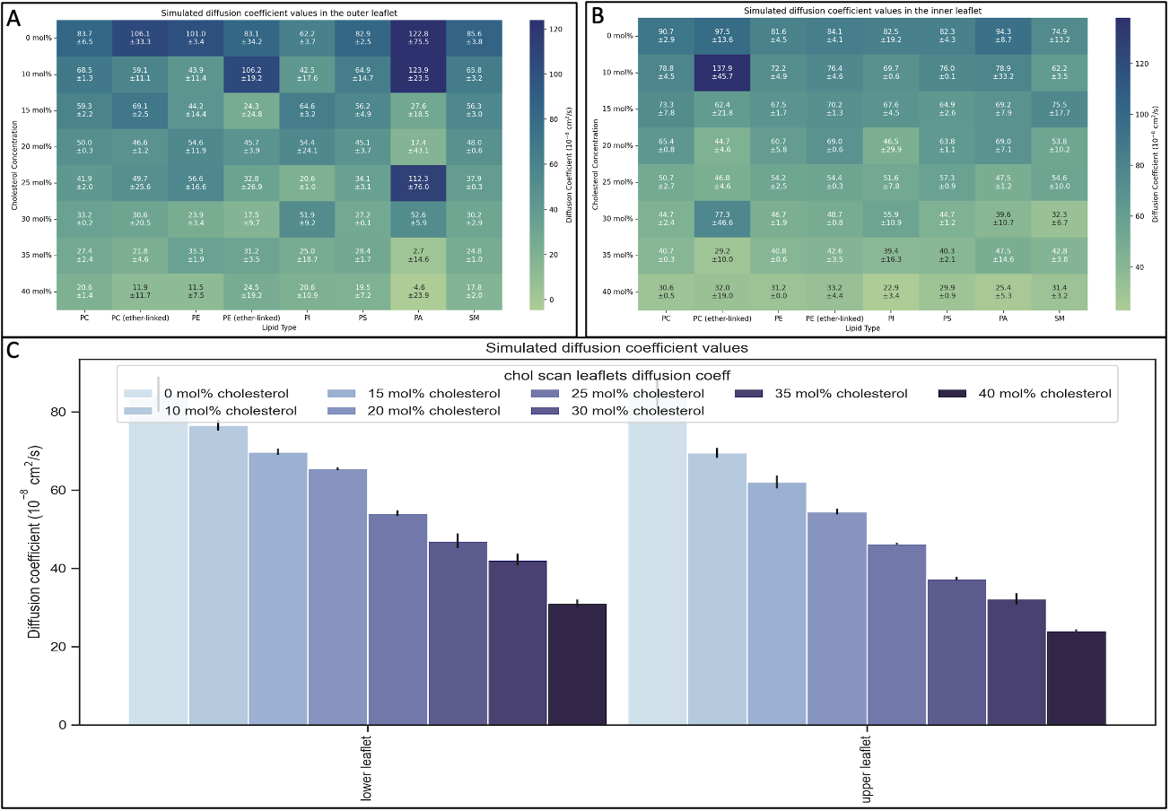
Results: Diffusion Coefficient
Diffusion coefficient decreases as cholesterol concentration rises in both leaflets.
Despite a few large errors in rare lipid types, the decrease trend is consistent within all lipid types in both leaflets.

Slide 11
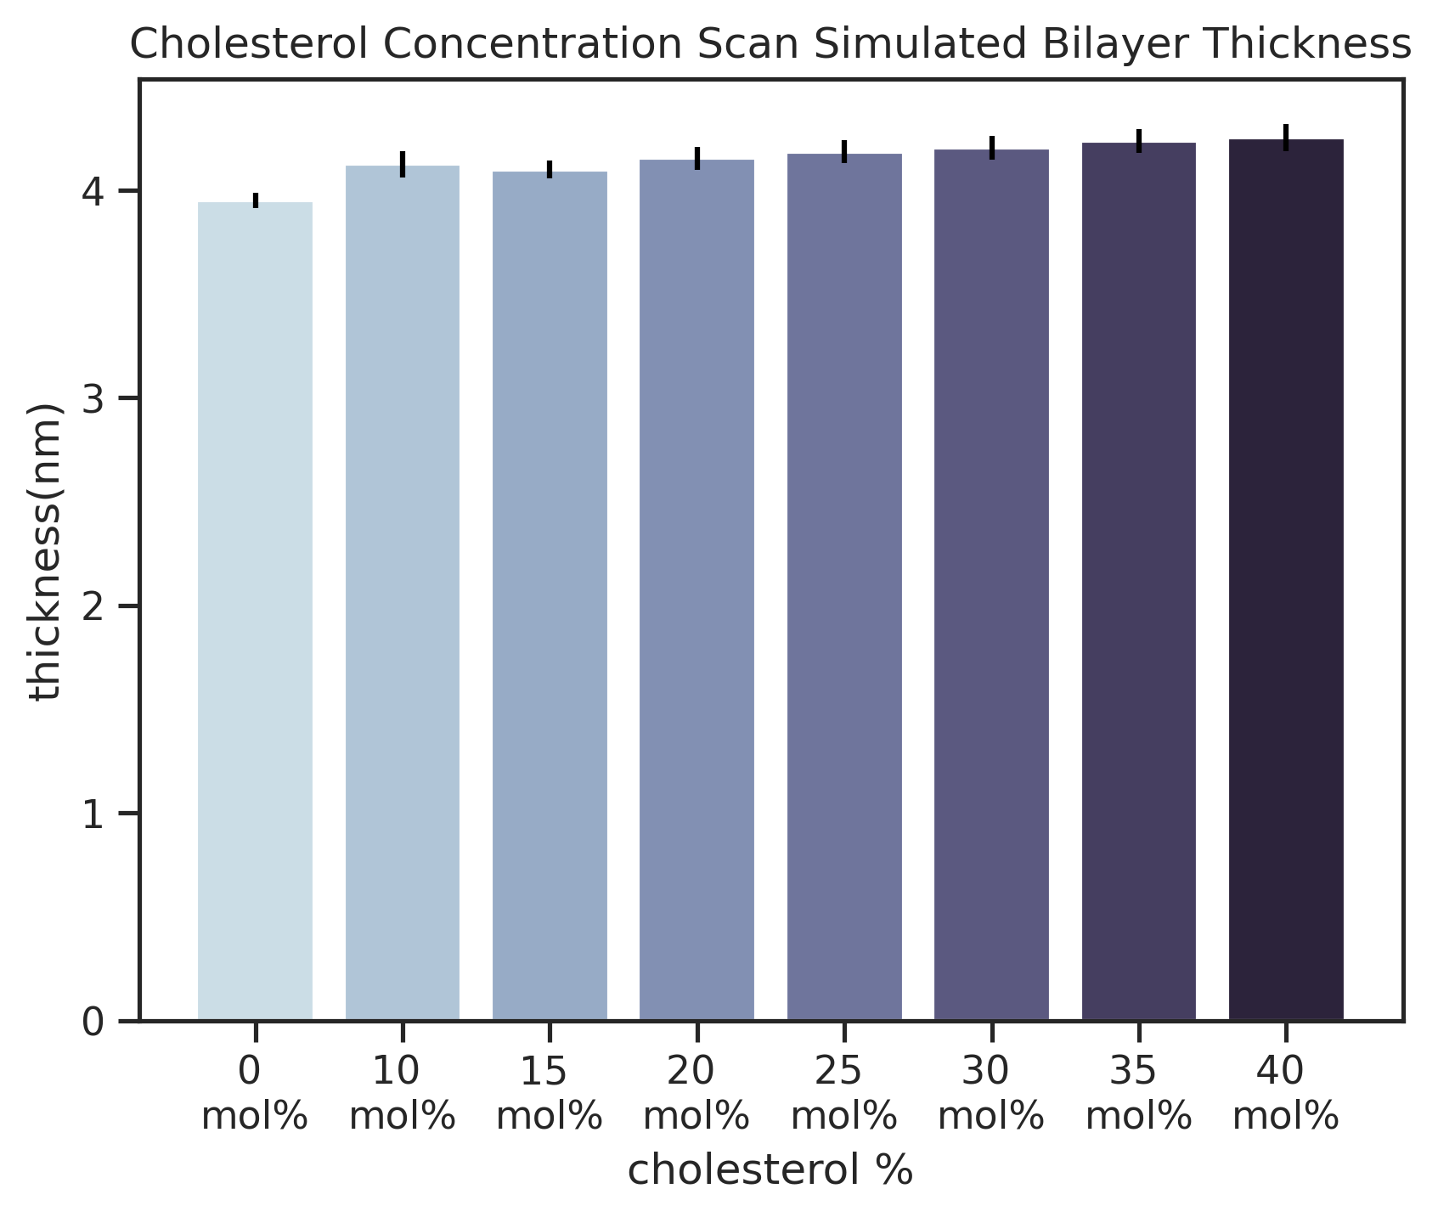
Results: Bilayer Thickness
The membrane bilayer gradually thickens as cholesterol concentration increases

Slide 12
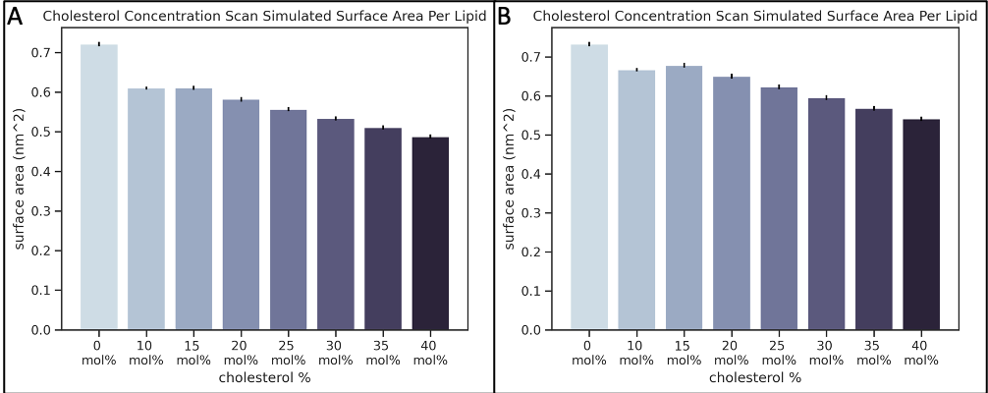
Results: Surface Area per Lipid
Outer leaflet
In both leaflets, higher cholesterol concentration leads to a lower surface area per lipid
In the outer leaflet, there is a steep decrease between the 0mol% and the 10mol% experiments
inner leaflet

Slide 13
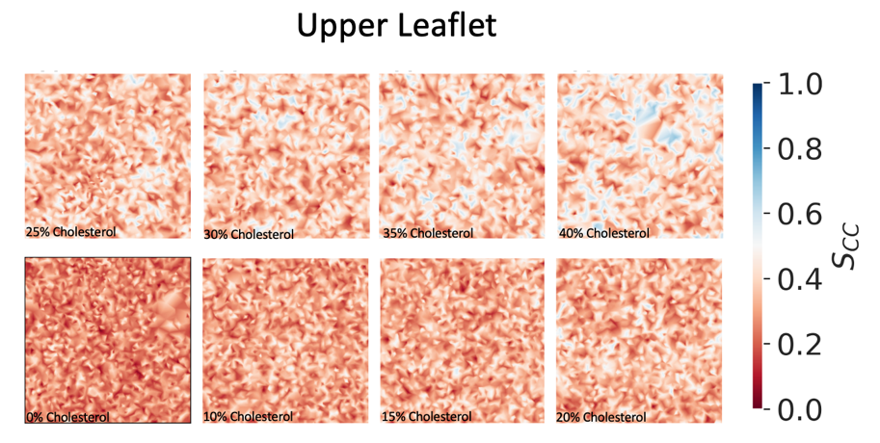
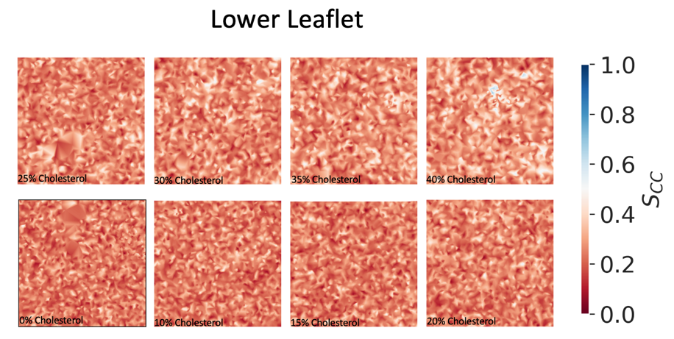
Results: Order Parameter
A
Outer leaflet
B
Inner leaflet
Order parameter greatly increases with cholesterol concentration in the outer leaflet
Order parameter slightly increases as cholesterol concentration rises in the inner leaflet, but not as significantly as in the outer leaflet

Slide 14
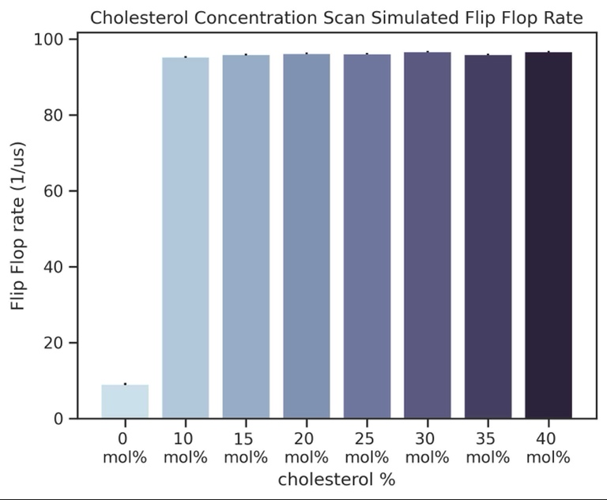
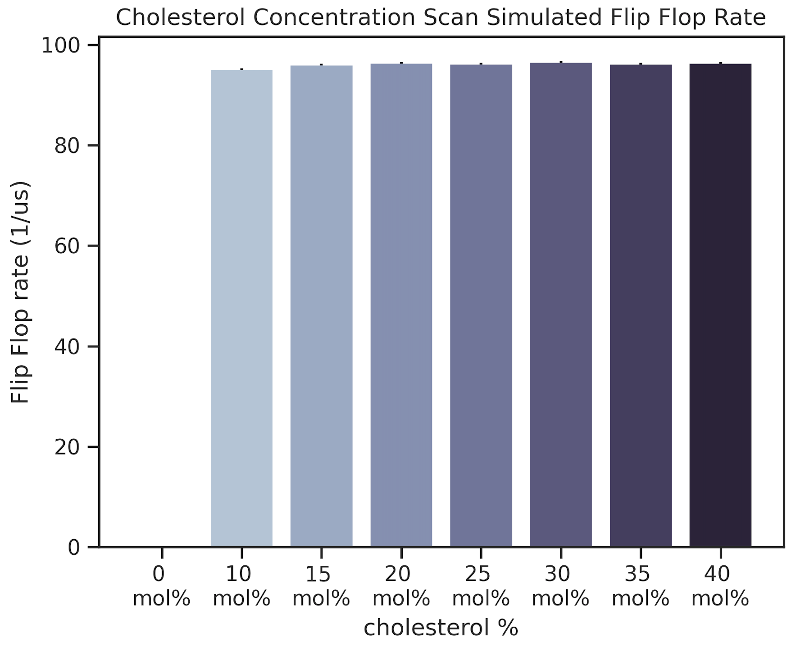
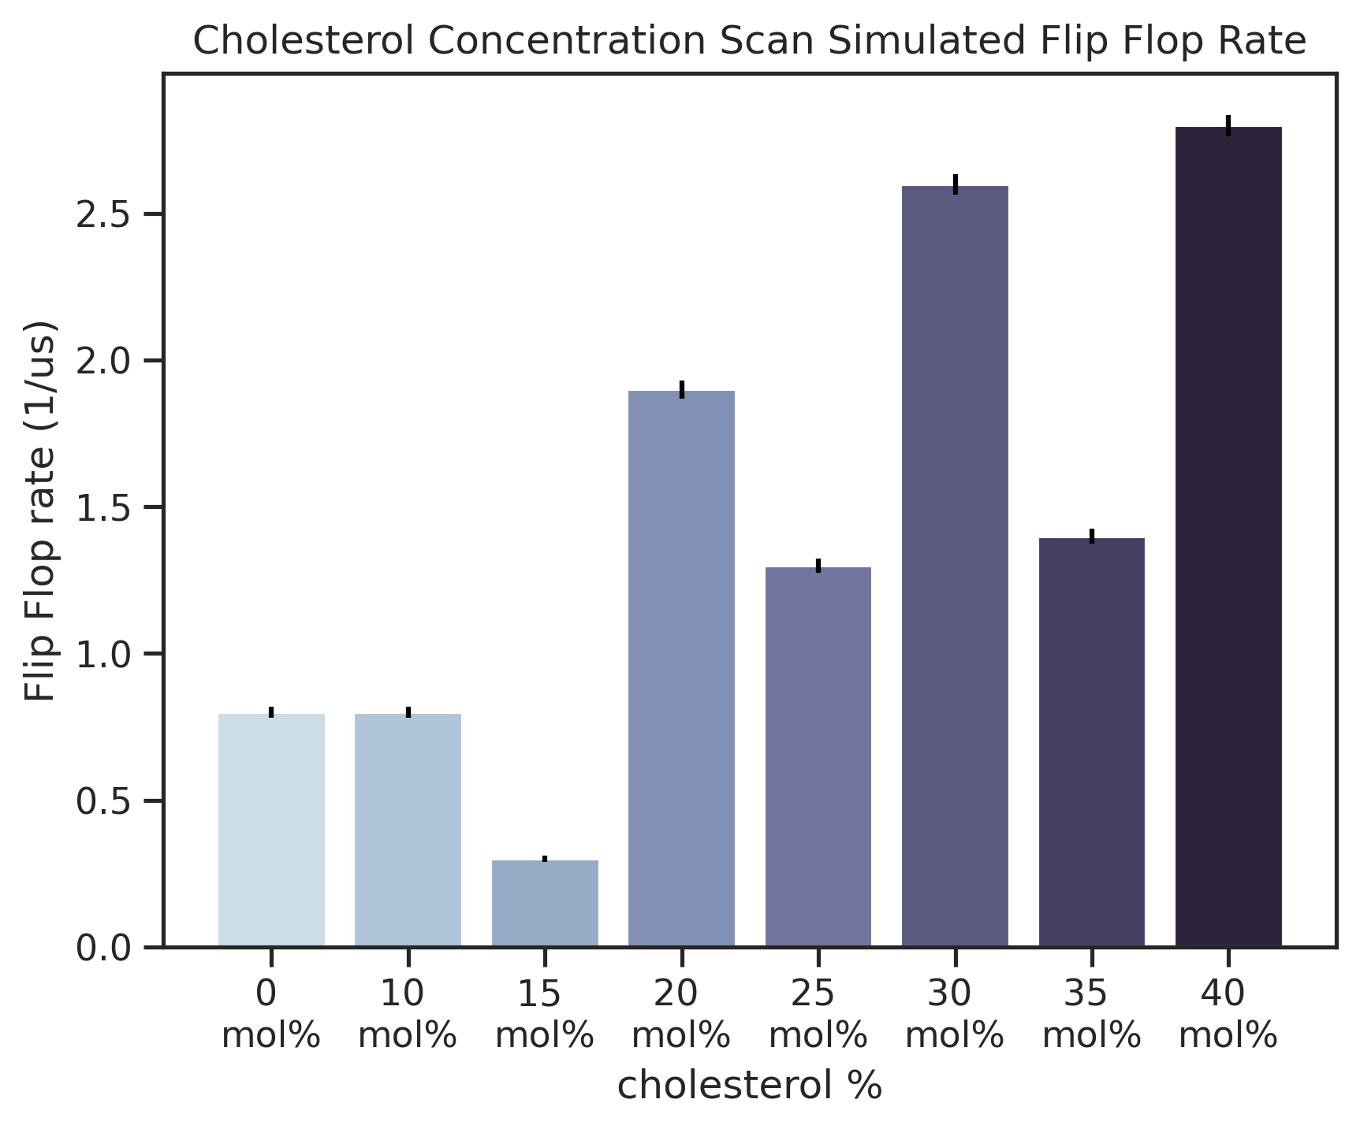
Results: Flip-Flop rate
A
B
Total leaflet
Cholesterol
C
Flip-flop rate changes dramatically with and without cholesterol
Cholesterol concentration doesn’t effect its flip-flop rate
Cholesterol effect on PS flip-flop is inconsistent
PS

Slide 15
Discussion – Cholesterol Concnteration and Lipid Rafts
At the moment, there isn’t a well agreed-upon way to measure lipid rafts in Coarse-Grain simulations. In previous literature, the liquid-ordered (L_{o}) phase, a sort of lipid crystal in the membrane, was used to asses presence of lipid rafts
Order parameter can be used as an indication of L_{o}, as the order of an area tells us of its liquidity and state. As such, the increase in order parameter we witnessed hints us that cholesterol concnetration may increase lipid rafts formation.
This is strengthened by the decrease in diffusion coefficient. The more phospolipids bind to cholesterol in the formation of lipids rafts, they move less and the membrane turns more solid – as we see in our results.

Slide 16
Discussion – Flip-Flop and the Membrane
As we didn’t simulate any flip-flop inducing enzymes, the flip-flop rate is dependent only on spontanious flip-flop
The major shift in the rate we see in the presnce and absence of cholesterol and the similar results of the entire membrane and the cholesterol alone. This suggests that cholesterol is the main lipid going through flip-flop
This fits the fact that while most lipids have strong interactions with water, cholesterol doesn’t – thus allowing it to flip-flop spontanousaly, unlike other lipids
Other lipid’s flip-flop is most likely random due to the simulations tendency to mistakenly count aggregates as flip-flops, as we see in the random pattern of PS flip-flop rate

Slide 17
Discussion – Structural Changes to the Membrane
Our results show an increase in membrane thickness. It is to be expected based on literature, since the cholesterol interactions with lipid’s tail chains expands them, thus thickening the bilayer
Our results also suggest an increase in membrane rigidness. As mentioned, the increased order parameter is associated with the more stabilaized L_{o}, since it means the steric disorder is reduced, meaning a more solid and rigid membrane. This is also strengthend by the diffusion coefficient, since less movement is another indicator of this state.
Lesser surface area per each lipid is an additional sign for membranal structural changes that undergoes as cholescterol concentration changes.

Slide 18
Conclusion
Our data shows the significant influence cholesterol mediates other a variety of membranal core properties and behaviors such as it thickness and order phase, and its lipids surface area, flip-flop rate and diffusion coefficient.
All of this expands our understanding of membranal cholesterol, and might enrich our understanding of related cardiovascular diseases and other curios phenomena related to the rich world of lipids complexity.

Slide 19
Thanks!
I wish to thank all the people who helped with this project:
Prof. Anat Barnea & Dr. Einat Hazkani-Covo from the Open University for the supervision
Dr. Tamir Dingjan & Prof. Tony Futerman from Weizmann Institute of Science for the guidance, help and support

